Slide 1
NODE.JS
KAVITHA K AP/CSE

Slide 2
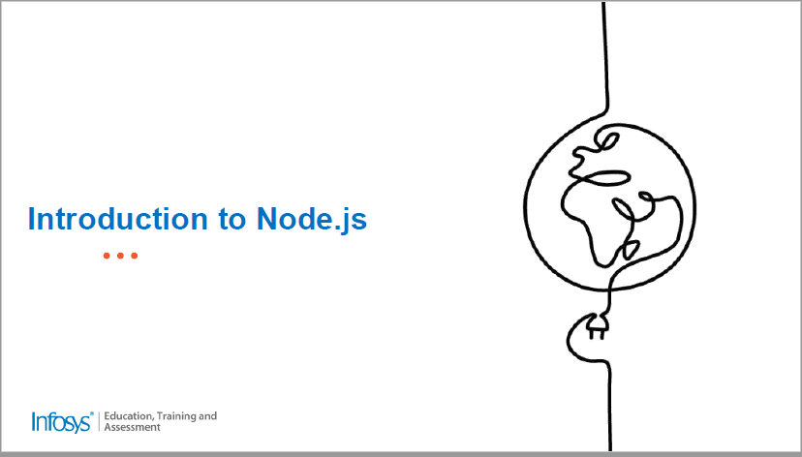

Slide 3
Introduction
Node.js is an open source Run-time server environment
Node.js is free
Node.js runs on various platforms (Windows, Linux, Unix, Mac OS X, etc.)
Node.js allows you to run JavaScript on the server.
Server-Side JavaScript Programming
Node.js , PHP, ASP, JSP, Perl, Ruby, Python…..
Adv: Node.js - we can create our own server and port
Used to store in the Database/ Retrieve from DB/etc....

Slide 4
Initially js code can be executed only in browser and it is used only to create web pages
Later it is node js is developed which act as a run time environment for creating stand alone application using javascript

Slide 5
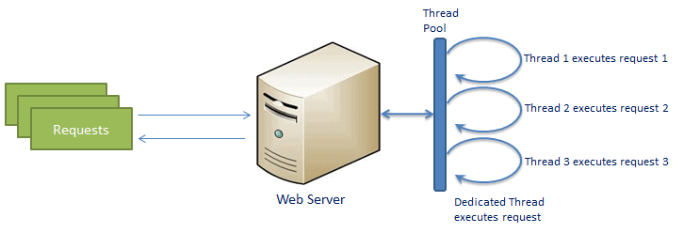
Web Server Models
A common task for a web server can be to open a file on the server and return the content to the client.
Traditional web server model

Slide 6
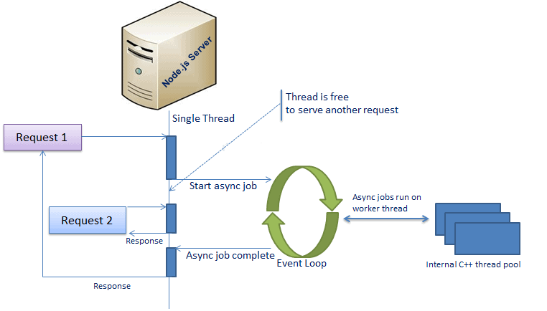
Node.js process model

Slide 7
Why Node.js?
If we need to store the data collected from forms when the form is submitted, We need to use either PHP/ Node.js etc..
Here is how PHP or ASP handles a file request
Here is how Node.js handles a file request
Sends the task to the computer's file system.
Waits while the file system opens and reads the file.
Returns the content to the client.
Ready to handle the next request.
Sends the task to the computer's file system.
Ready to handle the next request.
When the file system has opened and read the file, the server returns the content to the client.
Node.js eliminates the waiting, and simply continues with the next request.
Node.js runs single-threaded, non-blocking, asynchronously programming, which is very memory efficient.

Slide 8
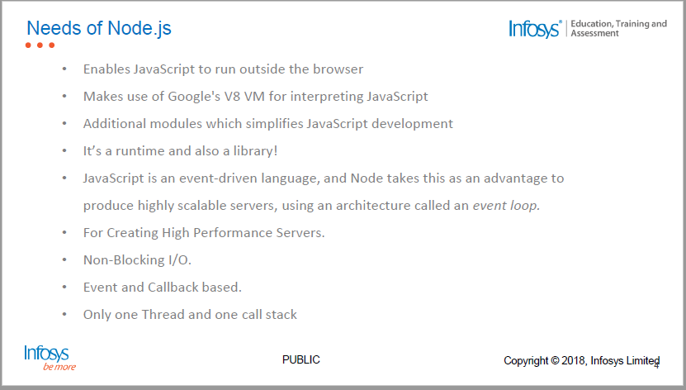
Need of Node.js

Slide 9
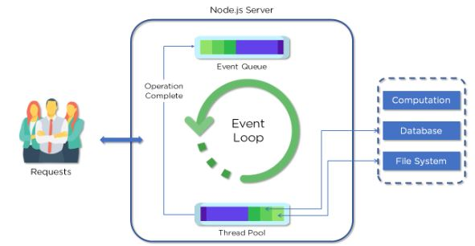
Node.js Architecture

Slide 10
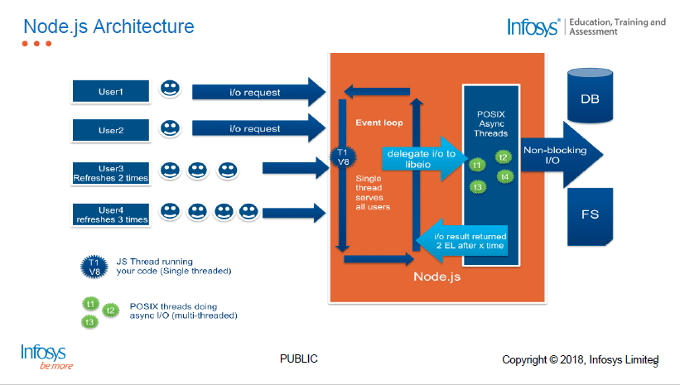
Node.js Architecture

Slide 11
What Can Node.js Do?
Node.js can generate dynamic page content
Node.js can create, open, read, write, delete, and close files on the server
Node.js can collect form data
Node.js can add, delete, modify data in your database

Slide 12
What is a Node.js File?
Node.js files must be initiated on the server before having any effect (Run the server first)
Node.js files contain tasks that will be executed on certain events
Node.js files have extension ".js"

Slide 13
Applications of node.js
Paypal
Netflix
Uber
Ebay
https://thinkmobiles.com/blog/node-js-app-examples/

Slide 14
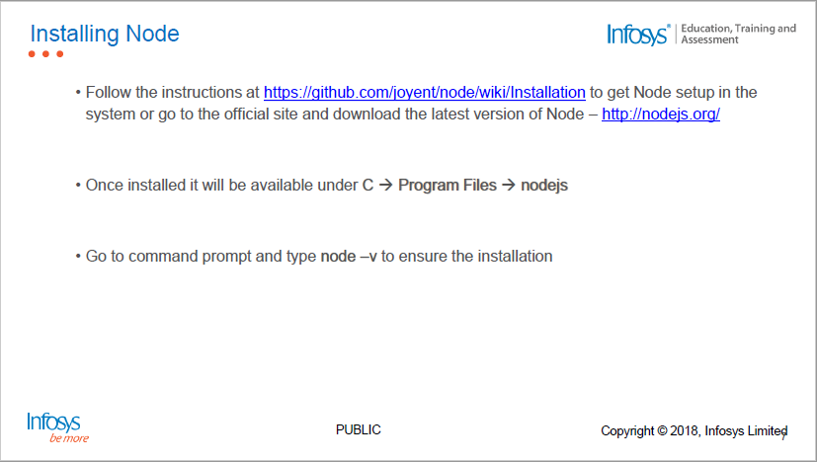
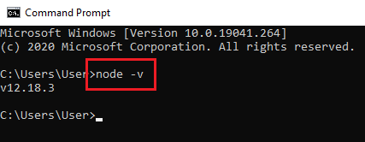
Installing Node.js

Slide 15
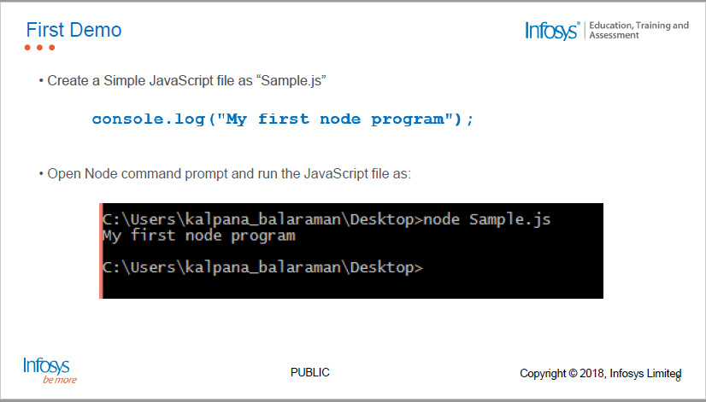
First Demo

Slide 16
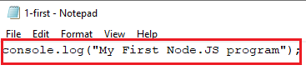
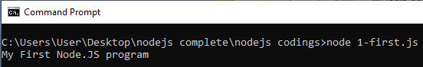
First Demo
Create a Simple JavaScript file as “1-first.js” with content
console.log() - Displays the contents in Node command prompt
response.write() – Displays the response in HTML page
Open Node command prompt and run the JavaScript file as:

Slide 17
To view node js modules & functions:
To view the modules and functions available in nodejs - goto
nodejs.org->docs->select version->

Slide 18
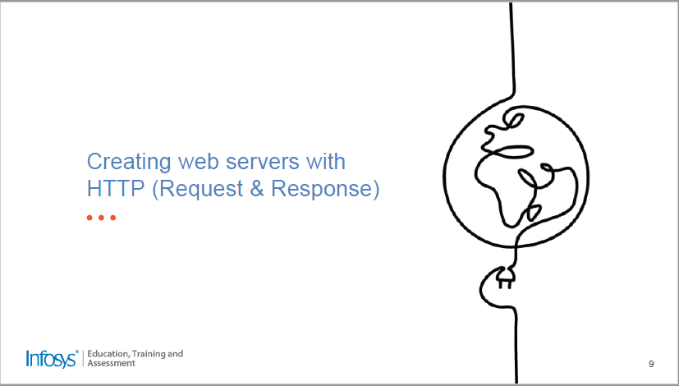

Slide 19
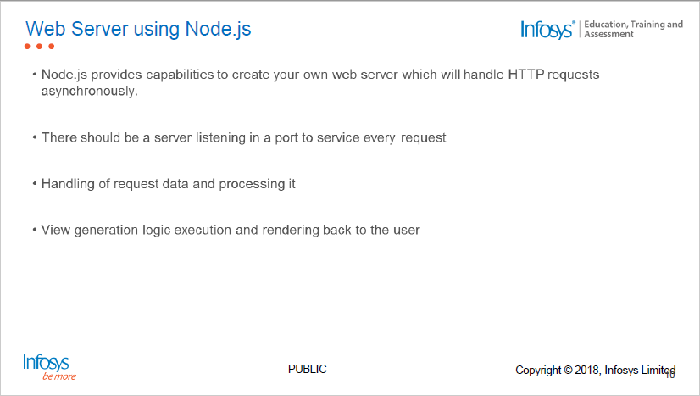
Creating Web Servers with HTTP
There is a server listening port to service every request

Slide 20
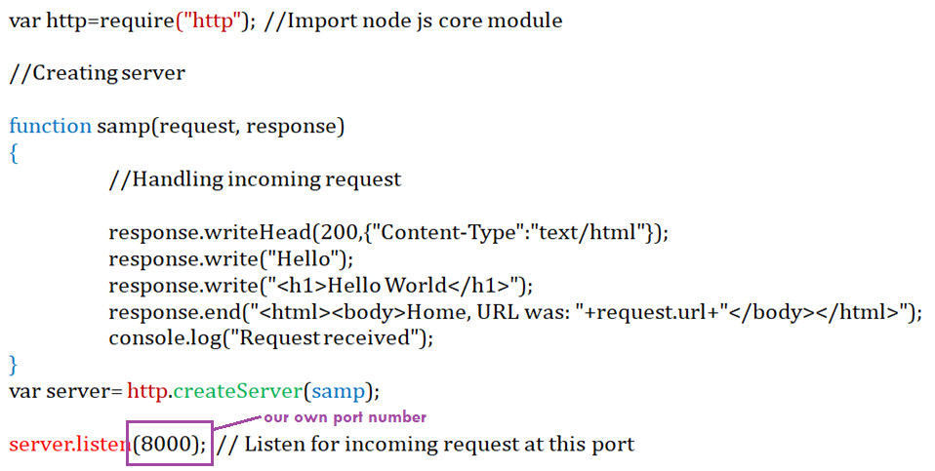
Creating Web Servers with HTTP– Method1
Create a server and listen to our own port number

Slide 21
Creating Web Servers with HTTP
http: Built in module allows Node.js to transfer data over the Hyper Text Transfer Protocol (HTTP).
require(): To include http module use this method
createServer(): To create an HTTP server that listens to server ports and gives a response back to the client.
The function passed into the http.createServer() method, will be executed when someone tries to access the computer on port 8000
http.createServer() method includes request and response parameters which is supplied by Node.js
Request object – used to get information about the current HTTP-request (e.g – URL, request header, data)
Response object – used to send a response for current HTTP request

Slide 22
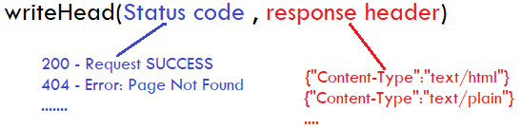
Creating Web Servers with HTTP
res.writeHead(): If the response from the HTTP server is supposed to be displayed as HTML, include this method.
sends a HTTP status code and a collection of response headers back to the client.
end(): Method sends both the content of the response to the client and acknowledgement/signals to the server that the response (header and content) has been sent completely
url: Property which holds the part of the url that comes after the domain name

Slide 23
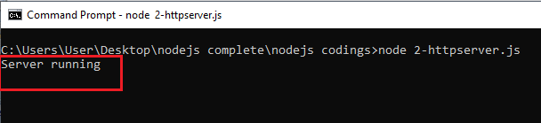
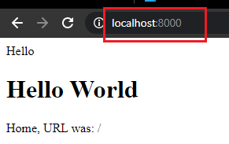
Executing Web Server
Execute the javascript file using Node command prompt to start the server
Once server started, then open the browser with the URL port number 8000 (which is specified in the js file)

Slide 24
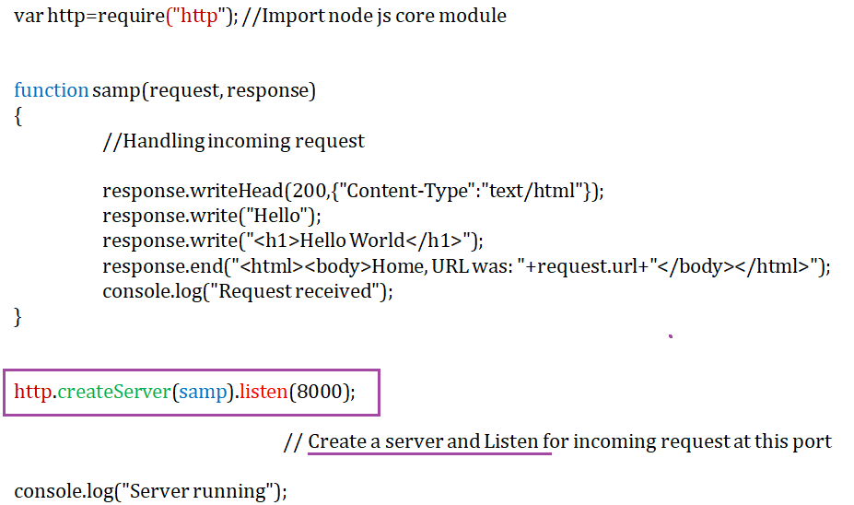
Creating Web Servers with HTTP– Method 2

Slide 25
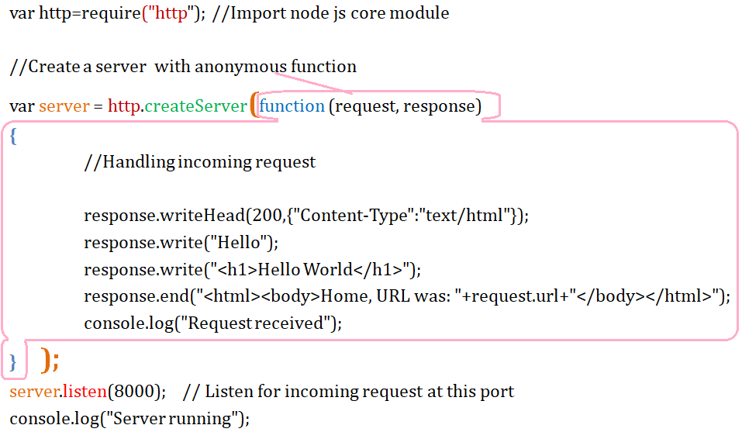
Creating Web Servers with HTTP– Method 3

Slide 26
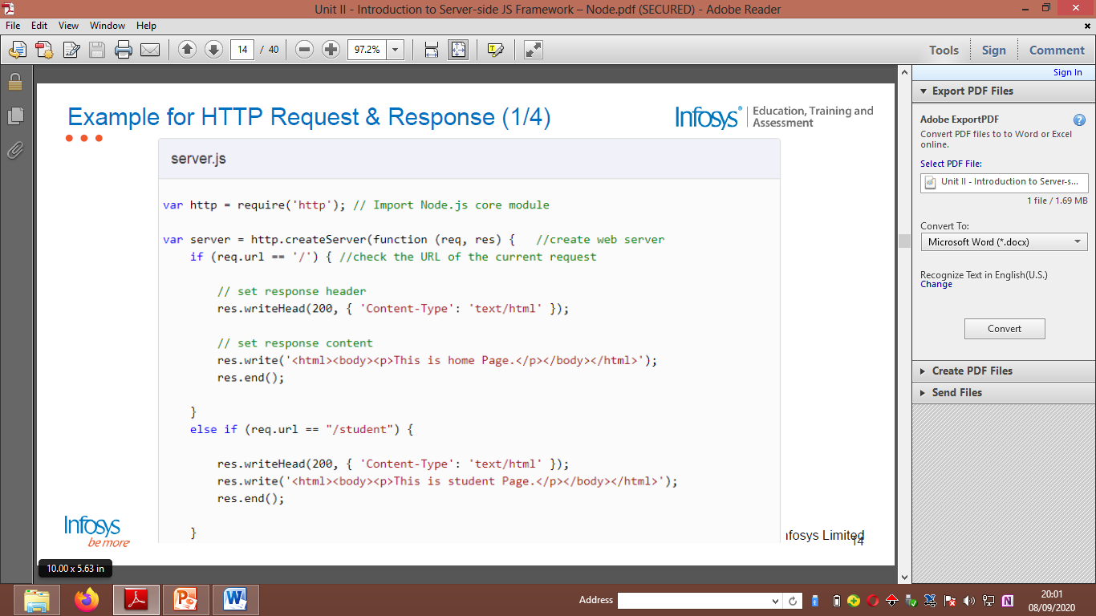
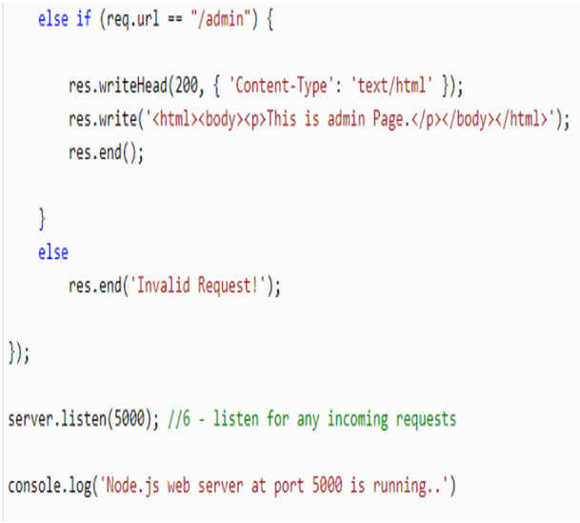
Creating Web Servers with HTTP (Request and Response)

Slide 27
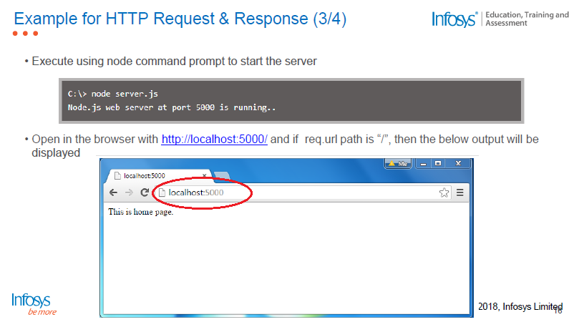
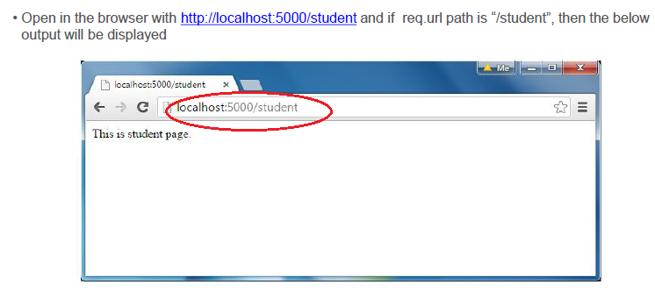

Slide 28
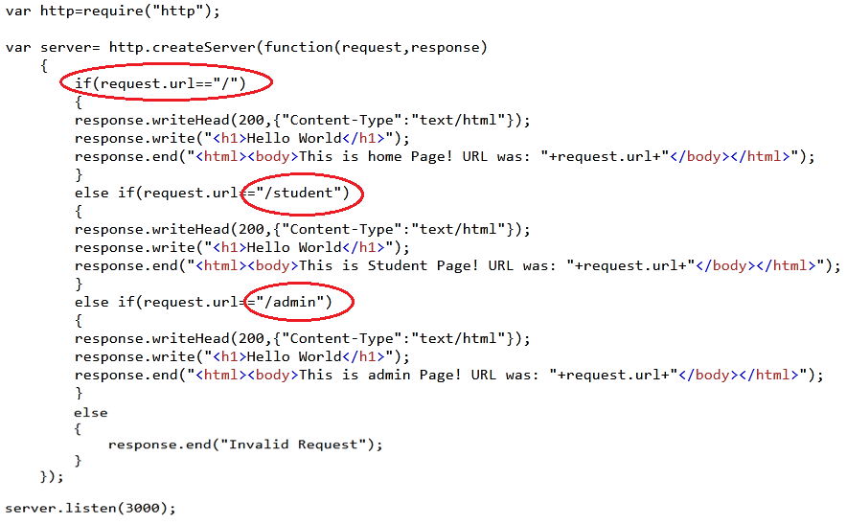
Example: Http request and response

Slide 29
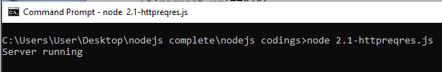
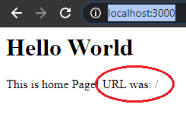
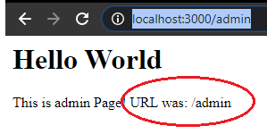
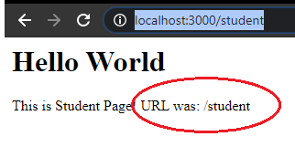
Example: Http request and response

Slide 30


Slide 31
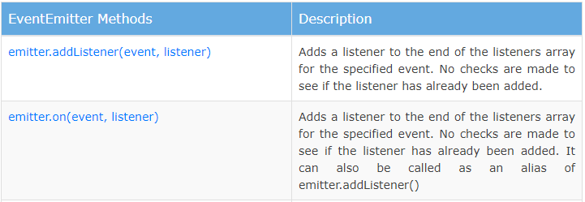
Event Handling
Node js allows us to create and handle custom events by own
events: Node js built in module that is used to create, fire and listen for own events
To include the built-in Events module use the require() method.
EventEmitter: Event handler can be assigned to events using event emitter object.
emit(): Used to fire/invoke an event
on(): Used to create event with 2 args - Event name & Function to be executed on event

Slide 32
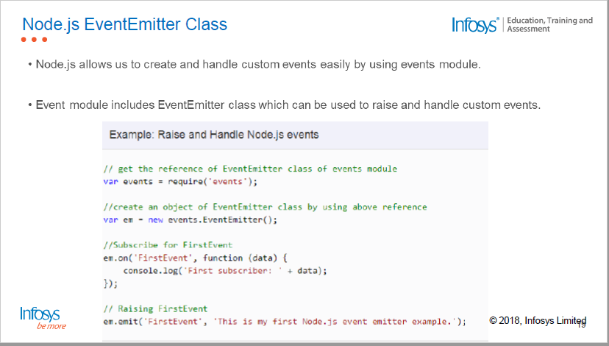
Event Handling

Slide 33
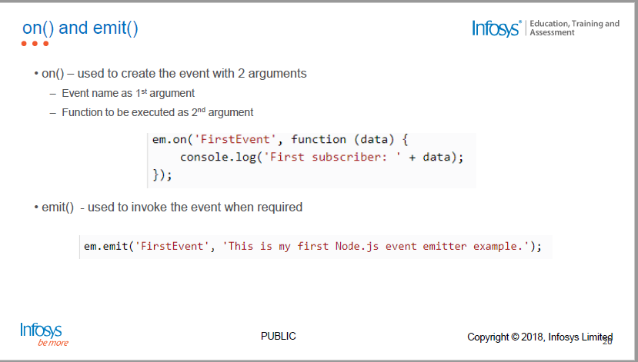
Event Handling

Slide 34
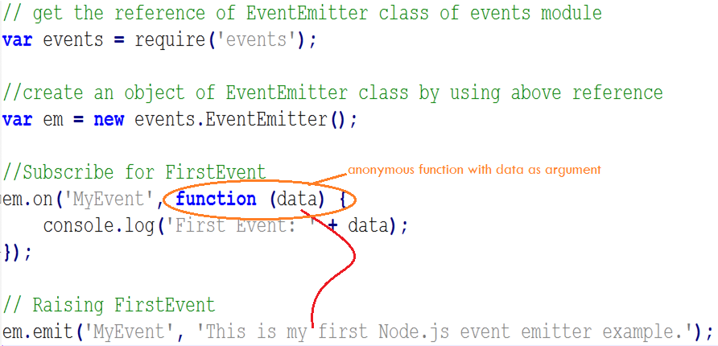
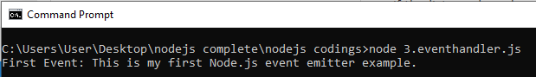
Event Handling

Slide 35
Event Handling
GET Method
POST method
the submitted form data will be visible in the page address field (eg.: /action_page.php?firstname=Mickey
Appends form-data into the URL in name/value pairs
The length of a URL is limited (about 3000 characters)
Never use GET to send sensitive data! (will be visible in the URL)
Useful for form submissions where a user wants to bookmark the result
GET is better for non-secure data
the submitted form data will not be visible in the page address field
POST has no size limitations
can be used to send large amounts of data
Form submissions with POST cannot be bookmarked

Slide 36
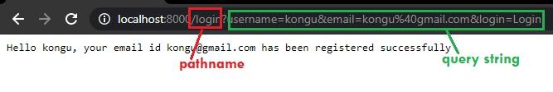
Event Handling- Get Method
url: Built in module splits up a web address into readable parts
url.parse(): takes a URL string, parses it, and returns a URL object
Parse address and it will return a URL object with each part of the address as properties
querystring: The Query String module provides a way of parsing the URL query string.
querystring.parse(): Parses the querystring and returns an object
pathname: Path section of the URL, that comes after the host and before the query, including the initial slash if present.
Example: url.parse('http://localhost:8000/login').pathname gives us /login
get() will show request parameter in URL and it can be easily retrieved using URL and query string modules

Slide 37
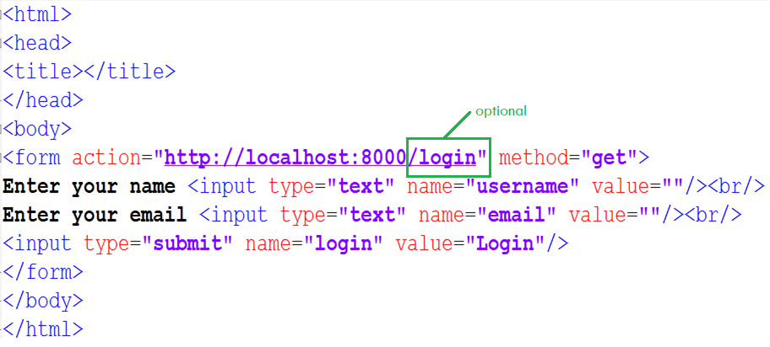
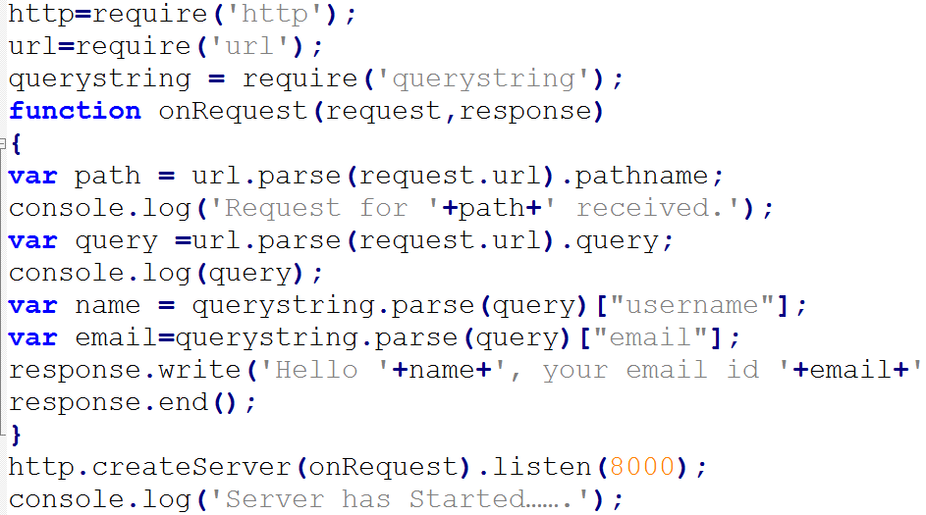
Event Handling-Get Method
login_get.html
nodeget.js

Slide 38
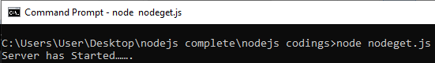
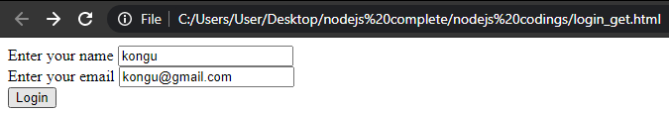
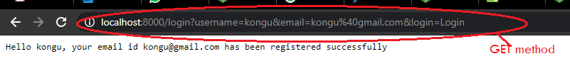
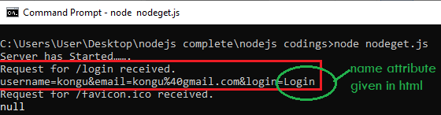
Event Handling-Get Method (Output)
Start server in console
Run login.html
Output - Once the Login button is clicked, it will submit the action to http://localhost:8000/login to process http request and response using get()

Slide 39
Event Handling -Post Method
post() will process the request parameter using on() method of EventEmitter class and built-in events like ‘data’ and ‘end’
data: Data event gets invoked/emitted when the requested parameter is ready to read. Initially the data will be available as buffer. Convert that into string for readable format.
end: Event get emits when there is no available data to read.

Slide 40
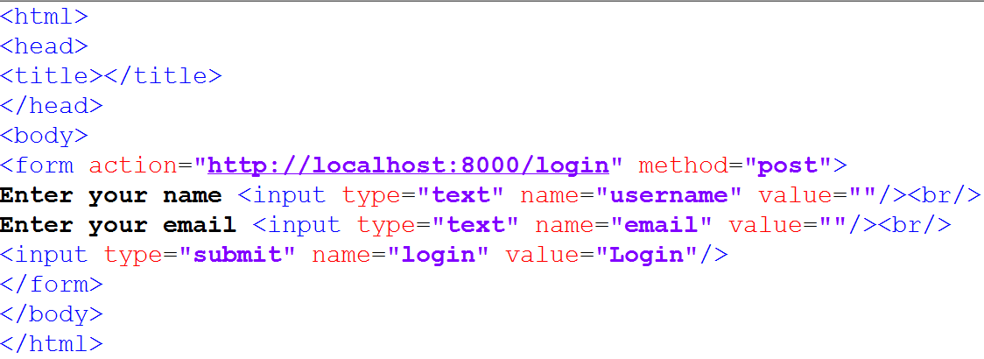
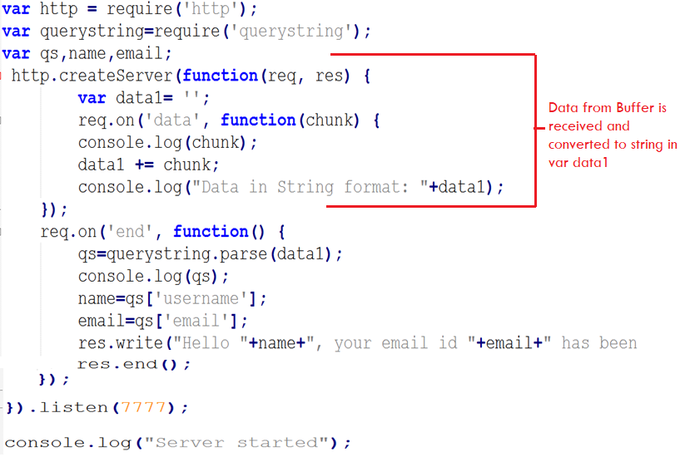
Event Handling -Post Method
login_post.html
nodepost.js

Slide 41
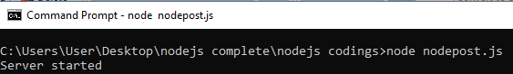
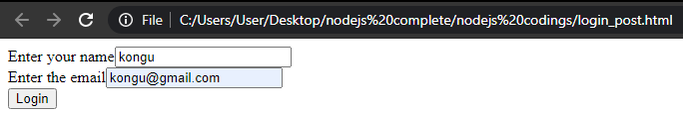
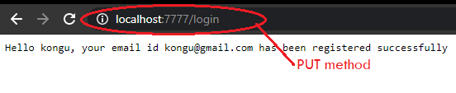
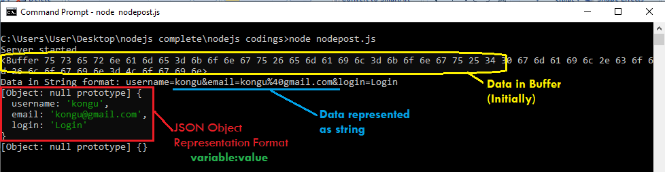
Event Handling -Post Method- Output
Start server in console
Run login_post.html
Note: Once the Login button is clicked, it will submit the action to http://localhost:7777/login to process http request and response using post()

Slide 42
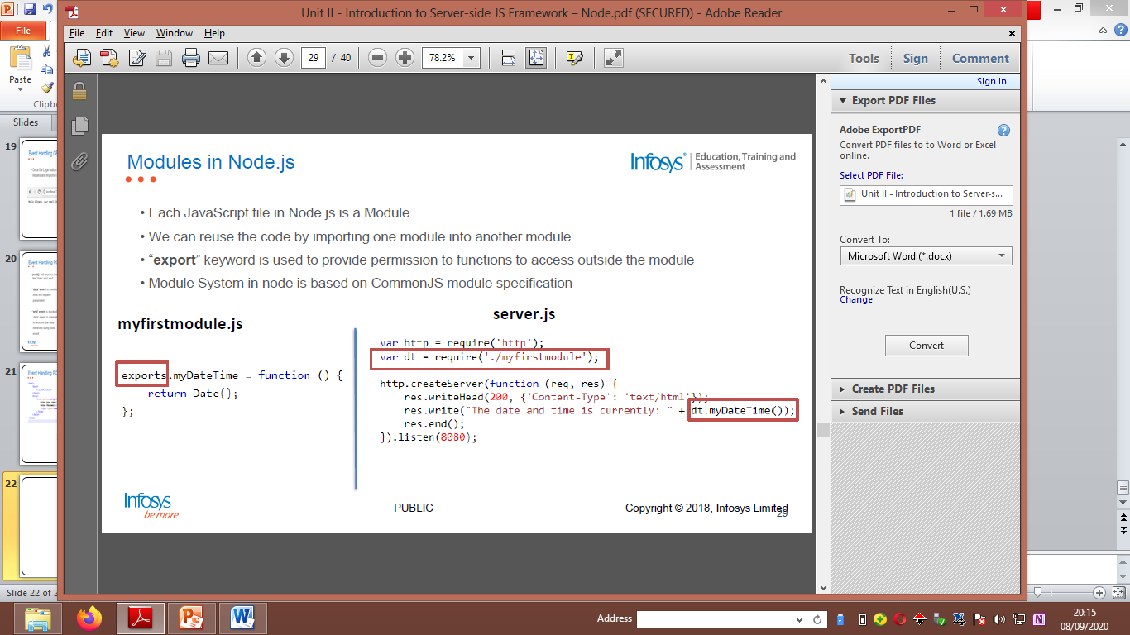
Modules in Node.js

Slide 43
Creating own module in node.js
Code reusability
User can create own module in node js
exports: Keyword to make properties and methods available outside the created module file.
Note:
./ is used to locate the user defined module, which means the module is located in the same folder as the Node.js file.
Specify the full path - otherwise

Slide 44
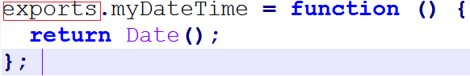
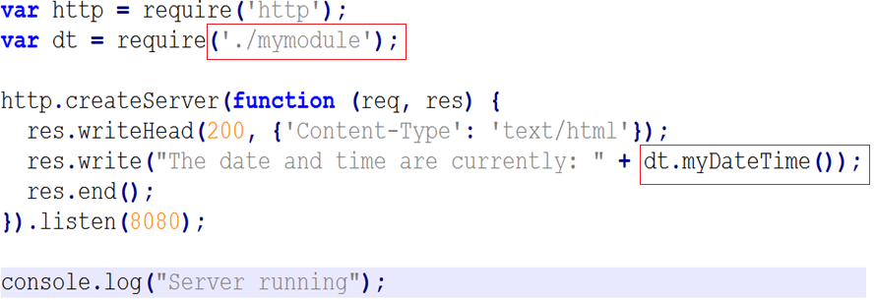
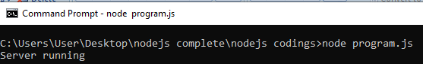

Creating own module in node.js
mymodule.js
Program.js

Slide 45


Slide 46

NoSQL

Slide 47

Classification of NoSQL Databases

Slide 48

Why to use MongoDB?

Slide 49
About MongoDB
NoSQL
Not only SQL
Unstructured data
Unstructured Query Language
Support for Dynamic Queries
Storing Binary Data
Uses GridFS to store binary data – stores upto 4MB of data
Data stored in JSON format

Slide 50


About MongoDB

Slide 51


Slide 52


Slide 53


Slide 54


Slide 55

Downloading MongoDB

Slide 56


Installation Steps
Mongo DB Website: https://www.mongodb.com/
Step 1: Download Link: https://www.mongodb.com/try/download/community?tck=docs_server
Step 2: Download .msi file and then install
Step3: Create a data folder “D:/data/db….”
Step4: Steps to Start the server
4.1 : Open Command Prompt
4.2 : Set the path to C:/program files/mongodb/server/4.0/bin>
4.3 : Use the command mongod --dbpath “D:/data/db” (or)
mongod --storageEngine=mmapv1 --dbpath=“D:/data/db"

Slide 57

Installation Steps
Step5: Steps to Start the Client
5.1 : Open Command Prompt
5.2 : Set the path to C:/program files/mongodb/server/4.0/bin>
5.3 : Use the command to start the client mongo

Slide 58


Slide 59

Data Types

Slide 60

Basic Commands

Slide 61

Data Representation – JSON

Slide 62

Structure of MongoDB

Slide 63



Unique ID
If _id is given by the user – that id is used
If not given by user, ID is assigned automatically

Slide 64


Slide 65



To Start with…
Create a Database
> use dbname
( If already exists with same name– use it, Otherwise, create new)
Create Collections
> db.createCollection(“collection_name”);
Insert data as documents
> db.collection_name.insert(…..);

Slide 66

Collections in MongoDB

Slide 67


Slide 68


Slide 69


Slide 70


Slide 71


Slide 72


Slide 73


Slide 74


Slide 75


Slide 76

Other Operators

Slide 77


